Slide 1
Exploring the Data (EDA)
Know the city before you train a model or plan a route
Project RUSH HOUR | Stage 1: Explore
Notes:
[~20 sec] Hi everyone, I'm [your name]. In the last section you saw the big picture: a 60x60 city, a model that predicts, a planner that decides. Now I'll cover Stage 1 of the pipeline - Explore. This is EDA: Exploratory Data Analysis. Simply put, it means looking carefully at the data before we build anything. All numbers in my slides come from the actual training data in the Rush Hour repo.

Slide 2
Where EDA fits in the pipeline
1
Explore
2
Classify
3
Cost & block
4
Plan
5
Compare
Why start here?
What we get
Every later stage uses what we learn now. A wrong assumption about the data travels all the way to the route.
A visual picture of the city, the shape of the features, and evidence for choosing metrics and the blocking policy.
Notes:
[~45 sec] Quick recap from Section 1: five stages - Explore, Classify, Cost and block, Plan, Compare. We are at stage 1, highlighted. Why does it matter? Because each stage feeds the next. If we misunderstand the data, our model learns the wrong thing, the costs and blocks are wrong, and the ambulance gets a bad route. In a real emergency, that means lost minutes. EDA is cheap insurance. It also gives us the evidence we need later - Section 4's error analysis and Section 5's blocking policy both depend on what we learn here.

Slide 3
EDA in 5 steps
1
2
3
4
5
Load & look
Check quality
See the map
Classes & features
Spot risks
Understand first, plot second, conclude last.
Notes:
[~45 sec] EDA is not magic, it is a routine. Step 1: load and look - how big, what columns. Step 2: check quality - missing values, duplicates, odd values. Step 3: see the map - because our data is a city, we can actually draw it. Step 4: study the classes and features - how many cells are free, congested, blocked, and how features differ. Step 5: note the surprises - things that could trip up a model. The next slides follow exactly these steps using our real data.

Slide 4
The data: one row = one cell
Files
Columns
labelled/train_cells.csv
21,600 rows = 6 maps, with labels
labelled/test_cells.csv
7,200 rows = 2 held-out maps
scenarios/ (RUSH-1, 2, 3)
Features only, no labels
baseline_predictions/
Starter Random Forest outputs
row, col, map_id
Where the cell is (row 0 = top)
5 numeric features
speed, signal delay, traffic density, intersection density, incident probability
road_type
highway / arterial / collector / residential
Target: congestion_label
free_flow / congested / blocked
Notes:
[~1 min] First, what do we have? One CSV row is one cell of the city. A city map is 60x60 = 3,600 cells. Training file: 21,600 rows = 6 maps. Test file: 7,200 rows = 2 other maps - we only use it to evaluate, never to train. Scenario files are the maps we actually route on - they have features but NO labels, on purpose, because our route is judged against hidden truth. Baseline predictions are the starter Random Forest's guesses.
Columns: row and col are the location, with row 0 at the top and rows going downward. Five numeric features: average speed, signal delay, traffic density, intersection density, incident probability. Plus road_type, which is a category. The target is congestion_label: free_flow, congested or blocked. simulated_travel_cost is an optional extra number. Remember: the data is synthetic - generated from rules plus noise - so it is not real traffic.

Slide 5
Steps 1-2: First look and quality check
import pandas as pd
train = pd.read_csv(
"data/labelled/train_cells.csv")
train.shape # (21600, 11)
train.head()
train.info()
train.describe()
train.isnull().sum().sum() # 0
train.duplicated().sum() # 0
What we found
21,600 rows, 11 columns
0 missing values
0 duplicate rows
Speed: 3 to 77 km/h, median about 21
Incident probability: median 0.08, max 1.0
Notes:
[~1 min] Now the first look, using pandas. Four commands: shape, head, info, describe - and isnull().sum() and duplicated().sum() for quality. Results on our training file: 21,600 rows and 11 columns. Zero missing values and zero duplicates - this dataset is clean, which is not typical of real data. So we don't need to fix anything here.
But describe() still tells us useful things. Average speed ranges from 3 to about 77 km/h, with a typical value around 21. Traffic density is between 0 and 1 as expected. Incident probability is mostly low - median 0.08 - but goes up to 1. Always check that min and max values make sense - for example, a negative speed would be an error.

Slide 6
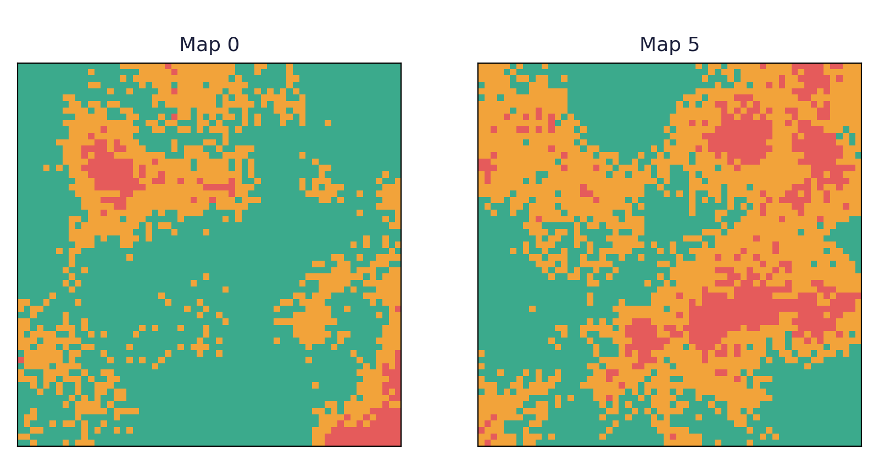
Step 3: See the city (reshape + imshow)
m = train[train.map_id==0]
grid = m.pivot(
index="row",
columns="col",
values="label_num")
plt.imshow(grid)
Notice
free flow
congested
blocked
Congestion forms blobs; maps differ a lot.
Notes:
[~1.5 min] This is the fun part, and it is special to our data. Because one row is one cell with a (row, col) position, we can pivot the table into a 60x60 grid and draw it as an image with imshow. Here is the label drawn for two training maps. Green is free flow, amber is congested, red is blocked.
What do we see? Congestion is not random noise - it forms clusters, or blobs. Neighbouring cells tend to have the same label. That is because the data is synthetic and generated so that neighbours are alike. Also, Map 0 is mostly green, but Map 5 is full of amber and red. So maps differ a lot from each other. The code on the right is the core of it: pivot with row as index and col as columns, then imshow. One tip: first convert labels to numbers, 0 1 2, so imshow can draw them.

Slide 7
Step 4a: How balanced are the classes?
Blocked is rare
Only about 8% of cells, but it matters most.
Mix changes
Train and test differ, and so do individual maps.
Notes:
[~1.5 min] Now count the labels with value_counts(normalize=True). Across all training cells: about 62 percent free flow, 30 percent congested and only 8 percent blocked. Blocked is the rare class - but it is the one that matters most for an ambulance.
Two big lessons. First, ACCURACY MISLEADS. A model that says free flow everywhere would be right about 62 percent of the time and still miss every blocked road. So we will use confusion matrix, recall and macro-F1 in Section 4.
Second, the mix changes between maps. Map 0 is 4 percent blocked, Map 5 is 13 percent blocked. And look at the test set: 48 percent free, 43 percent congested - quite different from training. So a model can face a different mix than it was trained on. Use groupby on map_id to see this.

Slide 8
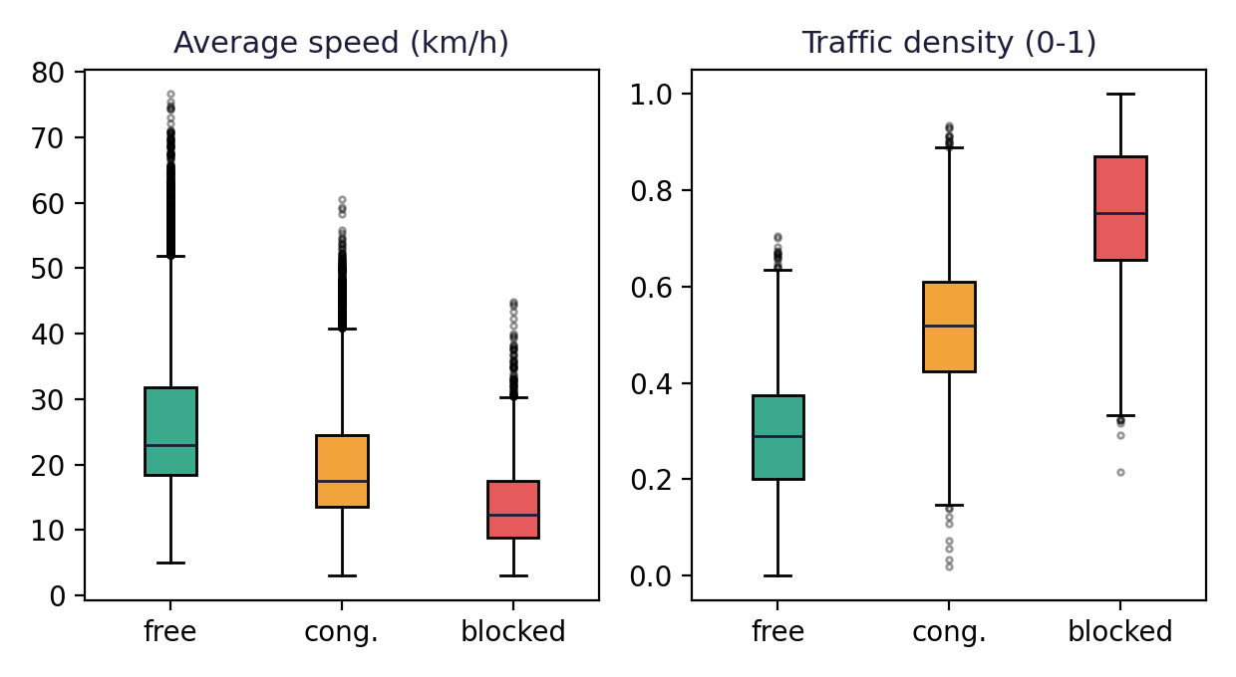
Step 4b: Do features tell the classes apart?
Clear trend
Slower speed and higher density go with worse labels, but boxes overlap.
Surprise
Blocked share is 7-9% for every road type, so road_type alone says little.
train.groupby("congestion_label")[feats].median()
Notes:
[~1.5 min] Next: do the features actually separate the classes? Use groupby on the label and look at the mean or median, or draw box plots like these. Left: average speed. Free flow cells have a median speed of about 23 km/h, congested about 18, blocked about 12. Right: traffic density. Median 0.29 for free flow, 0.52 for congested, 0.75 for blocked. So lower speed and higher density go with worse labels. That is exactly what we hope a model can learn.
But the boxes overlap - there is no clean line. So no single feature is enough, and that is why we need machine learning.
A surprise: road_type. We might expect highways to behave differently, but the share of blocked cells is about 7 to 9 percent for every road type. So road_type alone doesn't predict the label here. EDA saves us from assuming that it does.

Slide 9
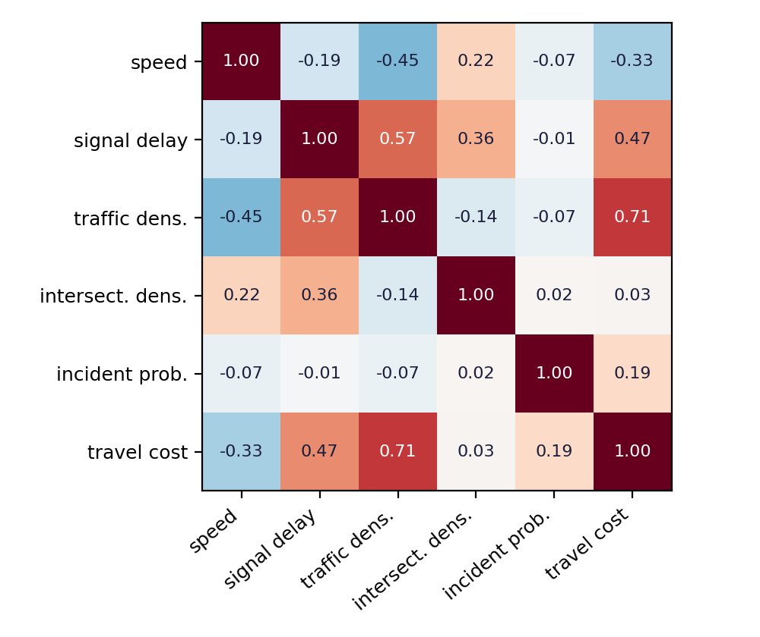
Step 4c: How do features relate to each other?
Density and cost: +0.71
Denser traffic, higher travel cost.
Density and delay: +0.57
More traffic, longer signal waits.
Speed and density: -0.45
More traffic, lower speed.
Notes:
[~1 min] A correlation heatmap, made with train[cols].corr(). Numbers run from -1 to +1. Near zero means no linear relationship. Three things to point out. Traffic density and travel cost have a strong positive correlation, 0.71 - denser traffic, higher cost. Traffic density and signal delay: 0.57. Speed and density: -0.45 - the more traffic, the slower. Meanwhile intersection density and incident probability are close to zero with most others - they carry different information.
Remember: correlation is not causation, and correlation only captures straight-line relationships. Also note that simulated_travel_cost is only in the labelled files, not in the scenario maps, so we cannot use it as a feature when routing.

Slide 10
Step 5: Watch-outs EDA reveals
Distribution shift
Leakage
Test maps have a different label mix than training (48/43/9 vs 62/30/8).
Neighbouring cells are alike. Split by map_id, not by random rows.
Skew and outliers
Synthetic data
Incident probability is skewed; speed has a long upper tail. Check before removing.
Rules plus noise. Good scores here are not proof for the real world.
Notes:
[~1.5 min] Finally, the risks EDA warns us about. 1) Distribution shift: the test maps have a different class mix from training. So good training results may not carry over. 2) Leakage: we must split by map_id, not by random rows. Neighbouring cells look alike, so a random split would put near-copies in both train and test, and the score would look better than it really is. Also simulated_travel_cost exists only in labelled data, so it must not be a feature. 3) Outliers and skew: incident probability is skewed - most cells are low, a few are high - and speed has a long upper tail, with the top 1 percent above 59 km/h and a maximum of about 77. We shouldn't delete these automatically; they might be real events. 4) Synthetic data: everything is generated from rules plus noise, so results show what the simulation does, not real traffic. We will come back to all of these in Sections 3 to 5.

Slide 11
Key takeaways
One CSV row = one cell; reshape to 60x60 to see the city
Data is clean, but only about 8% of cells are blocked
Slow speed and high density go with worse labels, with overlap
Maps and test set differ: split by map_id, avoid plain accuracy
Next: Machine Learning on these same features
Thank you. Questions?
Notes:
[~30 sec + questions] To wrap up. EDA means understanding the data before modelling. Our city is 60x60 cells, one row per cell; the data is clean, but labels are imbalanced, with only about 8 percent blocked. Features trend with the label but overlap, so we need ML. Test maps differ from training, so we split by map and use better metrics than accuracy. Next section: Machine Learning - we train a classifier on exactly these features. Thank you - questions? If I don't know an answer, I'll say I'll check and come back.

Slide 12
DATA TACTIX.ML WORKSHOP
Notes:
Welcome. In about 20 minutes: what we predict, how trees and forests learn, and how to test without fooling ourselves.

Slide 13
Backup: EDA code cheat sheet
# Look and check
train.shape; train.info(); train.describe()
train.isnull().sum(); train.duplicated().sum()
# Class balance (overall and by map)
train["congestion_label"].value_counts(normalize=True)
pd.crosstab(train.map_id, train.congestion_label, normalize="index")
# Features vs label
train.groupby("congestion_label")[feats].median()
# Draw a map
g = train[train.map_id==0].pivot(index="row", columns="col", values="y")
plt.imshow(g)
# Correlations
sns.heatmap(train[feats].corr(), annot=True, cmap="RdBu_r")
Notes:
[Backup slide - use if someone asks how to do it in code, or screenshot it for the audience.] The same steps in code: load, check quality, class balance, groupby by map and by label, pivot and imshow for the map picture, and corr for the heatmap. Replace paths and column names as needed. Needs pandas and matplotlib.

Slide 14
Supervised learning
Learn from solved examples, then predict new ones.
Features (inputs)
Target (the answer)
speed · density · signal delay · intersections · incident risk · road type
→
free_flow
congested
blocked
Classification predicts a category. Regression predicts a number. Ours is classification.
Notes:
Features are inputs, the target is the answer. Two types: classification (category) and regression (number).

Slide 15
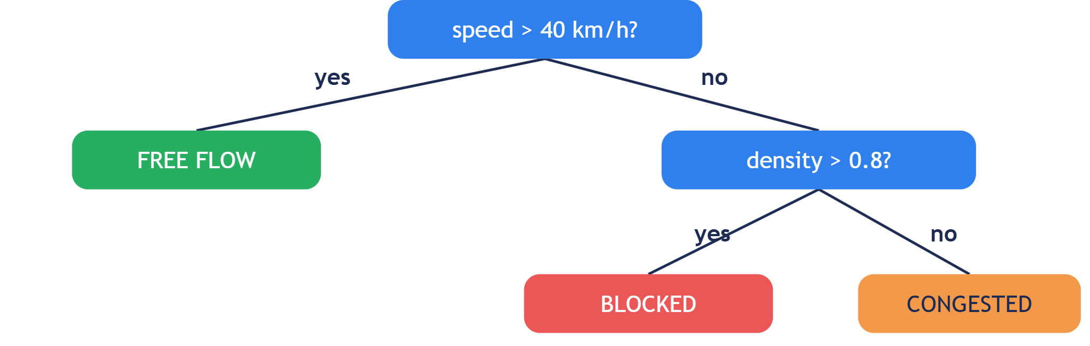
Decision tree
Predicting means following the arrows. The hard part is choosing the questions.
Notes:
A flowchart of yes/no questions. Try: speed 15, density 0.9 gives blocked.

Slide 16
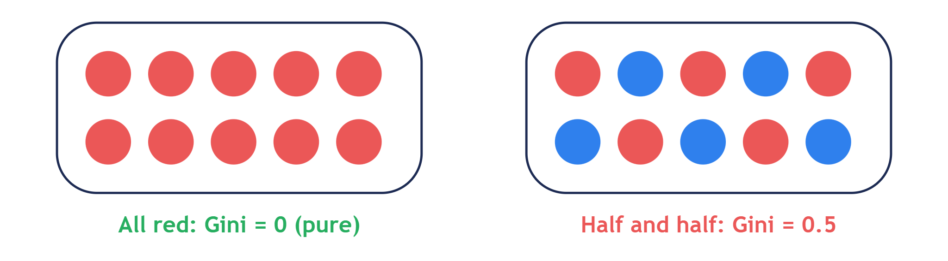
Gini impurity
Pick two balls (with replacement). Gini is the chance they differ.
Gini = 1 − Σ (share of each class)²
Notes:
All one class: 0. Half and half: 0.5. Three classes evenly: 0.67. The formula is a shortcut for the ball game.

Slide 17
Choosing a question
Cell | speed | density | label
A | 60 | 0.2 | free
B | 55 | 0.3 | free
C | 30 | 0.6 | congested
D | 25 | 0.7 | congested
E | 10 | 0.9 | blocked
F | 5 | 0.95 | blocked
Before any split: Gini = 0.67
Is speed > 40?
Yes {A,B}: 0 · No {C,D,E,F}: 0.5
(2/6)×0 + (4/6)×0.5 = 0.33 ✓
Is speed > 7?
Yes {A–E}: 0.64 · No {F}: 0
(5/6)×0.64 + (1/6)×0 = 0.53
Lowest weighted Gini wins. Then repeat inside each box until max depth.
Notes:
Weight each box by its size. The computer tries every feature and cut point and keeps the best.

Slide 18
Random forest
One tree is unreliable. Each tree sees random cells and random features, so each asks different questions. Then they vote.
Tree 1
Tree 2
Tree 3
→
Vote
congested
congested
blocked
congested
Notes:
Many different trees voting is steadier than one tree.

Slide 19
One-hot encoding
Models need numbers, but road_type is text. Give each category its own 0/1 column.
road_type | is_highway | is_arterial | is_collector | is_residential
highway | 1 | 0 | 0 | 0
arterial | 0 | 1 | 0 | 0
collector | 0 | 0 | 1 | 0
residential | 0 | 0 | 0 | 1
Don't code them 1, 2, 3, 4. That falsely says highway is "less than" residential.
Notes:
One column per category: 1 where true, 0 where false.

Slide 20
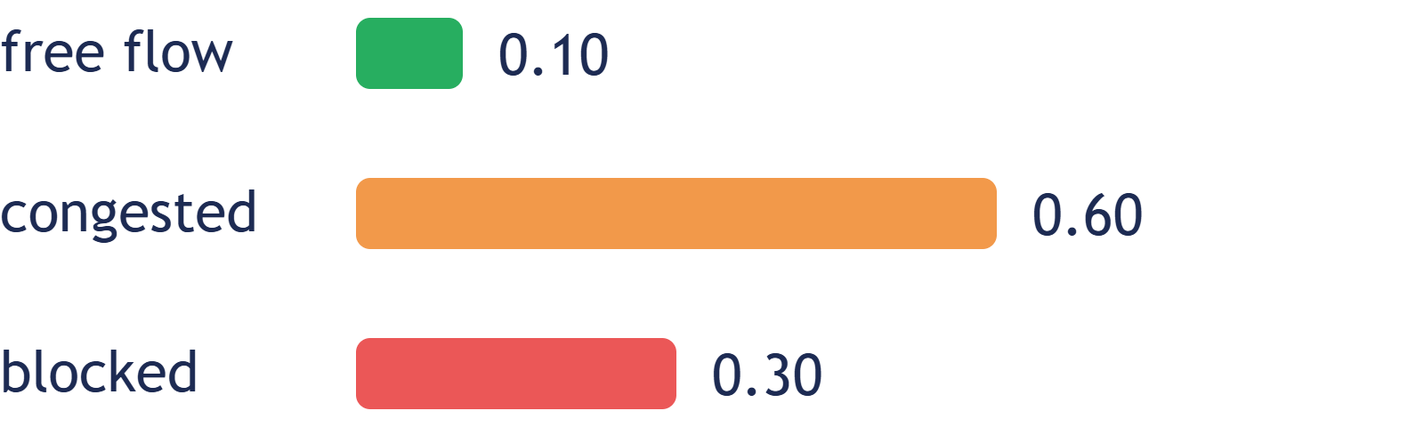
predict vs predict_proba
predict
predict_proba
One label
congested
The label hides a 30% chance the road is closed. An ambulance can use a congested road, but not a closed one.
With probabilities: avoid any cell with blocked probability above 0.25.
Notes:
predict reports the biggest number. Print classes_ to check column order before thresholding.

Slide 21
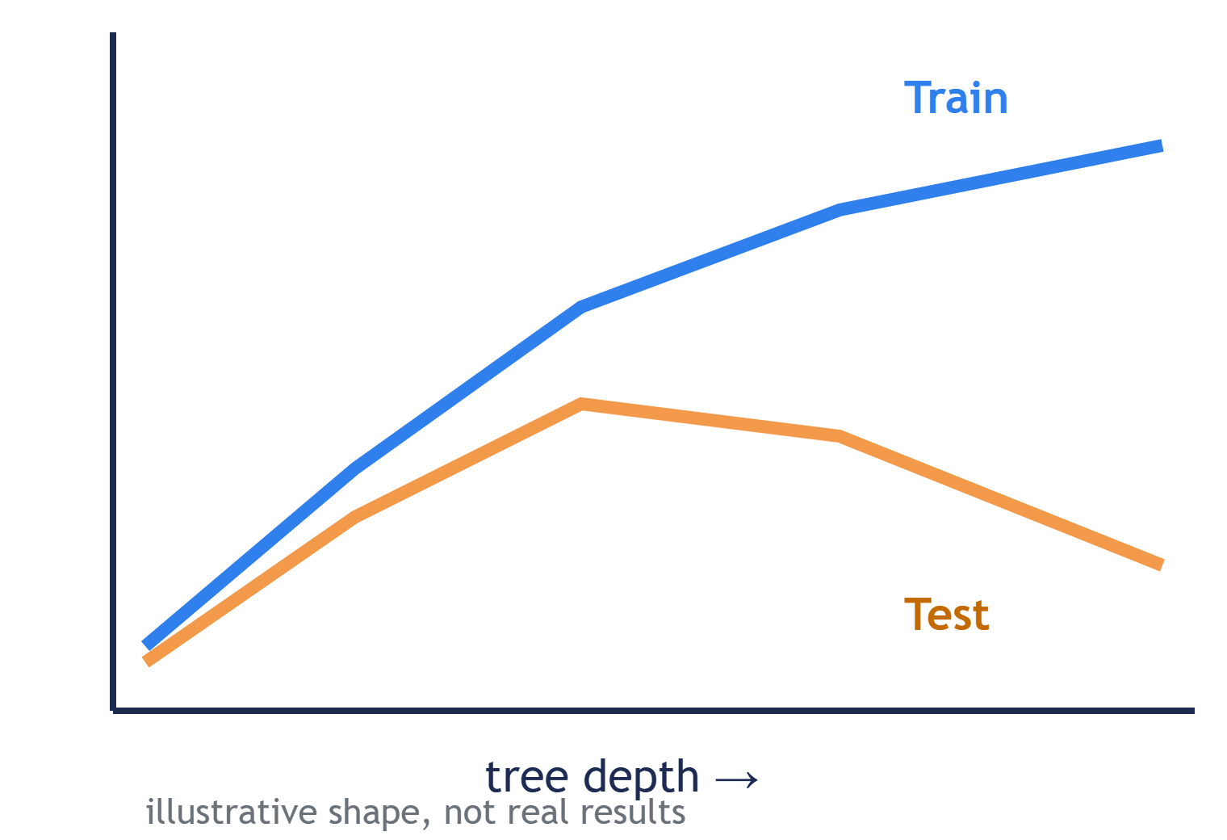
Train vs test, overfitting
Train: what the model learns from.
Test: data it never saw, so the score is honest.
Overfitting: memorizes the training data and fails on new data.
Fix: cap max_depth.
Notes:
Like memorizing last year's exam answers. Train accuracy climbs while test stalls or drops.

Slide 22
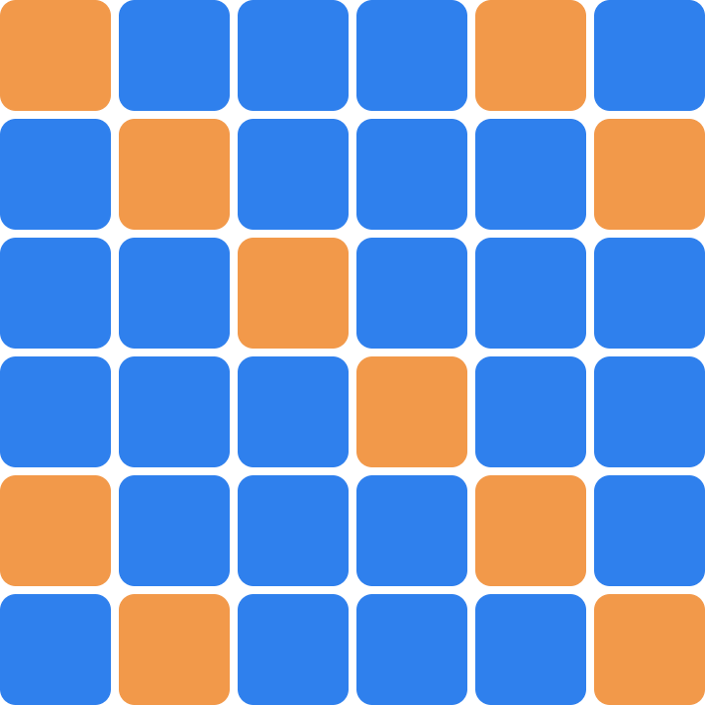
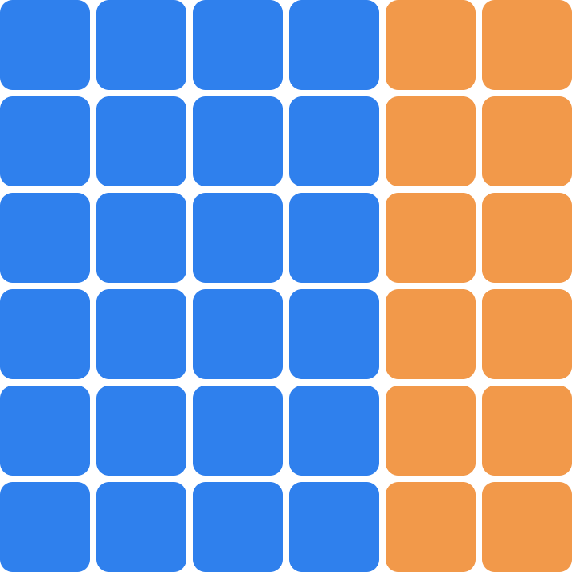
Leakage
Random split
Split by map_id
Each test cell has a near-twin in training. The model just remembers.
Whole maps are held out, like a city the model has never seen.
Blue = train · Orange = test. Leakage makes test scores look better than the model really is.
Notes:
Three lines: test information sneaks into training; neighbouring cells look identical; fix by holding out whole maps.

Slide 23
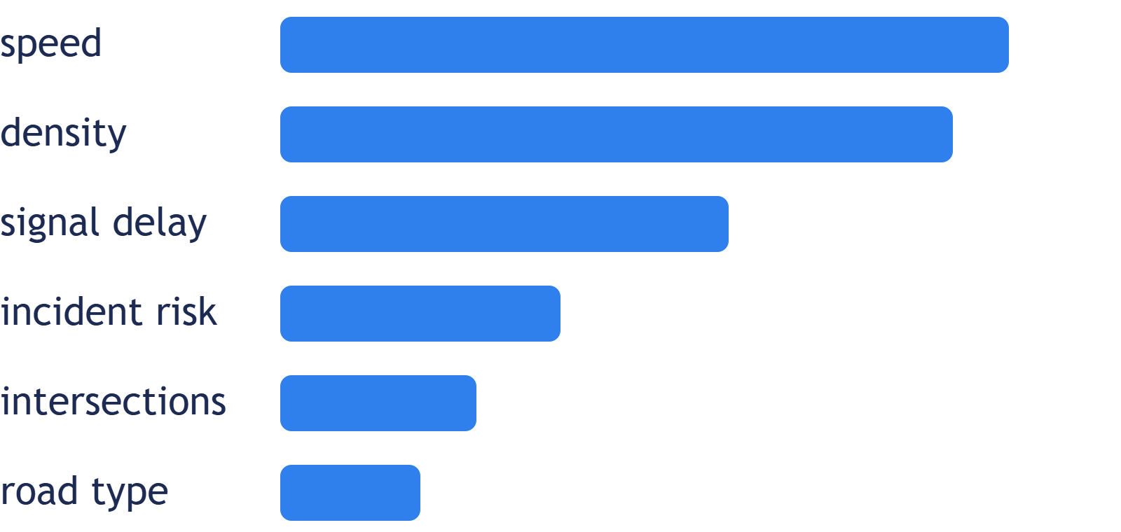
Feature importance
Ask a trained model which inputs it leaned on most. RUSH-2 asks which features drove the route.
It shows what the model uses, not what causes congestion. Features that move together split the credit.
Bars are an illustrative shape. Run it on your own model.
Notes:
Code: pd.Series(rf.feature_importances_, index=X_train.columns).sort_values().plot.barh()

Slide 24
The full RUSH HOUR pipeline
The model is one step in a larger system—not the whole route planner.
1
2
3
4
Map + traffic data
→
Prepare features
→
Predict a class
→
Choose a route
Each road cell has features such as speed, density and road type.
Clean missing values; encode categories consistently.
The trained model estimates free_flow, congested or blocked.
The routing layer uses those predictions as costs or restrictions.
Important: a good classifier helps, but route quality also depends on how the routing layer scores each road.
PROJECT RUSH HOUR · ML FOUNDATIONS

Slide 25
Before training: prepare the data
A model can only learn from the examples and columns it receives.
Check the rows
Keep features consistent
Check the labels
Remove duplicates and inspect missing or impossible values.
Use the same feature columns and category encoding at training and prediction time.
Make sure free_flow, congested and blocked mean the same thing throughout the dataset.
Train-time and prediction-time columns must match—in the same order and with the same meaning.
For categorical inputs, fit the encoder on training data and reuse it for new data.
PROJECT RUSH HOUR · ML FOUNDATIONS

Slide 26
Evaluate beyond accuracy
A single score can hide the mistakes that matter most for routing.
Illustrative confusion matrix
Track these together
Actual ↓
Predicted →
free_flow
congested
blocked
Confusion matrix
Shows which classes are mistaken for which.
free_flow
Correct
Mistake
Mistake
Mistake
Precision
When the model predicts “blocked,” how often is it right?
congested
Recall
How many truly blocked cells does it catch?
blocked
Macro F1
Balances precision and recall across all classes.
The example cells are illustrative—not results from the RUSH HOUR model.
PROJECT RUSH HOUR · ML FOUNDATIONS

Slide 27
Predictions become routing decisions
A predicted class is not automatically a route instruction; the system needs a policy.
free_flow
congested
blocked
Low travel cost
Higher travel cost
Avoid / forbid passage
Then decide how uncertainty should affect the route.
Example: avoid a cell if P(blocked) > 0.25
Tune the threshold to balance missed closures and unnecessary detours.
The 0.25 threshold is an example policy from this deck, not a universal best value.
PROJECT RUSH HOUR · ML FOUNDATIONS

Slide 28
What the model can—and can’t—tell us
Be clear about uncertainty before trusting predictions on new roads.
Training labels
If labels are noisy or inconsistent, the model can learn the wrong patterns.
New locations
A random split can look strong while performance drops on an unseen map.
Probabilities
A score of 0.30 is useful only if probabilities are checked for calibration.
Feature importance
Importance shows model reliance, not proof that a feature causes congestion.
Next steps: test on held-out maps, inspect class-wise errors, and validate probability thresholds.
PROJECT RUSH HOUR · ML FOUNDATIONS

Slide 29
Key takeaways
A quick recap before questions.
01
Learn from examples
Features in; traffic class out.
02
Trees split the data
Gini helps compare candidate questions.
03
Forests combine votes
One-hot encoding represents categories as numbers.
04
Test honestly
Hold out whole maps to reduce leakage.
05
Connect ML to routing
Use probabilities carefully and measure the mistakes that matter.
Questions?
PROJECT RUSH HOUR · ML FOUNDATIONS

Slide 30
How to evaluate the model
Accuracy, Confusion matrix, precision, recall, F1 and error analysis

Slide 31
Accuracy
01

Slide 32


Slide 33
50
Black
out of 100 balls

Slide 34
50%
Accuracy
if you always guess black

Slide 35
99
Black
out of 100 balls

Slide 36
99%
Accuracy
if you always guess black

Slide 37
Toy City
1,000
cells in total
940
free flow
50
congested
10
blocked

Slide 38
0 of 50 Congested cells found
But look at what it actually does:
94%
0 of 10
Blocked cells found
Correct: 940 out of 1,000, so accuracy = 94%.
It looks excellent on paper.
It is useless for the one thing the city cares about,
which is spotting the bad cells.

Slide 39
Confusion Matrix
02

Slide 40
Predicted class
 | Positive | Negative
Positive | True Positive (TP) Correctly predicted positive | False Negative (FN) Actually positive but predicted negative
Negative | False Positive (FP) Actually negative but predicted positive | True Negative (TN) Correctly predicted negative
Actual class

Slide 41
Toy city — Lazy model
Predicted class
 | Free | Congested | Blocked
Free | 940 | 0 | 0
Congested | 50 | 0 | 0
Blocked | 10 | 0 | 0
Correct predictions (diagonal): 940 / 1,000 = 94% accuracy
The Predicted Blocked column is empty: the model never predicts Blocked
Actual class
All 50 congested and 10 blocked cases are misclassified as Free

Slide 42
Toy city — Smarter model
Predicted class
 | Free | Congested | Blocked
Free | 920 | 15 | 5
Congested | 10 | 35 | 5
Blocked | 3 | 2 | 5
Correct predictions (diagonal): 920 + 35 + 5 = 960 → 96% accuracy
For true blocked (10 cases): 5 correctly predicted as blocked, 3 misclassified as free, 2 misclassified as congested.
Actual class
The model now predicts all three classes (unlike the lazy model).

Slide 43
Predicted class
Blocked is the positive class; all other cells count as negative (one vs rest).
 | Free | Congested | Blocked
Free | 920 | 15 | 5
Congested | 10 | 35 | 5
Blocked | 3 | 2 | 5
Actual class
True positive (TP)
False negative (FN)
False positive (FP)
True negative (TN)
Truly blocked, predicted blocked.
Truly blocked, predicted something else.
Truly not blocked, predicted blocked.
Truly not blocked, predicted not blocked.
(blocked row, blocked column)
(blocked row, not in blocked column)
(blocked column, not in blocked row)
(all other cells)
= 3 + 2
= 5 + 5
= 920 + 15 + 10 + 35
= 5
= 5
= 10
= 980

Slide 44
Precision
03

Slide 45
How many of my positive predictions were actually correct?
TP
Precision =
TP + FP
5
Example (blocked): =
= 0.33 (33.33%)
5 + 10

Slide 46
Recall
04

Slide 47
Recall = How many of the actual positives did I successfully find?
TP
Recall =
TP + FN
5
Example (blocked): =
= 0.50 (50%)
5 + 5

Slide 48
F1 & Macro F1
05

Slide 49
Precision × Recall
F1 = 2 ×
Precision + Recall
2TP
F1 =
2TP + FP + FN

Slide 50
F1 combines recall and precision by computing its harmonic mean
1
2
3
This means that it is dragged towards the lower of the two
You cannot hide a terrible recall behind a great precision, or the reverse

Slide 51
F1 example (blocked)
0.33 × 0.50
F1 = 2 ×
≈ 0.40
0.33 + 0.50
2 × 5
F1 =
= 0.40 (40%)
2 × 5 + 10 + 5
Precision 0.33 and recall 0.50 average to 0.42, but F1 is 0.40. It is pulled towards the lower of the two.

Slide 52
Macro F1: score each class, then average
 | Precision | Recall | F1
Free | 0.99 | 0.98 | 0.98
Congested | 0.67 | 0.70 | 0.69
Blocked | 0.33 | 0.50 | 0.40
Macro average | 0.66 | 0.73 | 0.69
Smarter model, one class vs the rest: compute precision, recall and F1 for each class.
Average the three F1 scores with equal weight: (0.98 + 0.69 + 0.40) / 3 = 0.69
Rare classes count as much as common ones, so a weak Blocked score pulls the average down.

Slide 53
Lazy vs smarter model
 | Lazy model | Smarter model
Accuracy | 94% | 96%
Blocked recall | 0 of 10 (0%) | 5 of 10 (50%)
Blocked precision | undefined (never predicts blocked) | 5 of 15 (33%)
Blocked F1 | 0.00 | 0.40
Macro F1 | 0.32 | 0.69
Accuracy barely moves (94% → 96%). Macro F1 more than doubles (0.32 → 0.69).

Slide 54
The Big Question
06

Slide 55
Is incorrectly identifying an open road worse than incorrectly identifying a blocked road?

Slide 56
Results in Asymmetric Error Costs

Slide 57
Core idea: the mistakes have different costs
False negative — missed hazard
False positive — false alarm
A blocked road is predicted as passable.
Possible consequence: a possible dead end, which can cost a failed or very late response.
An open road is predicted as blocked.
Possible consequence: an unnecessary detour of a few minutes.
Standard metrics like accuracy and plain F1 treat both mistakes as equal.
The real world doesn’t.

Slide 58
A Solution
07

Slide 59
The knob you control: the blocking threshold
The model outputs a probability of blocked for each cell: P(blocked).
Policy: treat the cell as blocked if P(blocked) > t (threshold t).
Lower threshold (e.g. t = 0.2)
Higher threshold (e.g. t = 0.7)
More cells are classified as blocked.
Fewer cells are classified as blocked.
0.1
0.3
0.4
0.6
0.8
0.1
0.3
0.4
0.6
0.8
t = 0.2
t = 0.7
Recall goes up
(you catch more real blocked cells).
Precision goes up
(fewer false alarms and detours).
Precision goes down
(more false alarms and longer detours).
Recall goes down
(more real hazards slip through).
Notes:
How to choose t
Put rough costs on each mistake, e.g. one missed hazard ≈ 10 minutes of lost time (illustrative), one detour ≈ 1 minute.
Pick the threshold that minimises the total expected cost.
That’s why the brief says to document and justify your blocking policy.

Slide 60
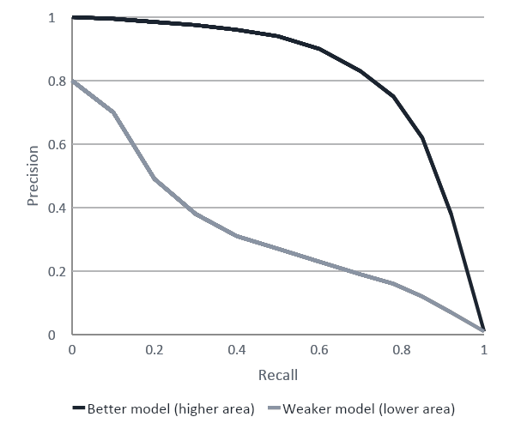
Precision–recall (PR) curve
Core idea
Each threshold t gives one (precision, recall) pair.
Vary t from 0 to 1 to get a curve.
A single-number summary is the area under the curve (average precision). Closer to 1 is better.
High precision, low recall (high threshold)
High precision and high recall (good model)
How to read the curve
X-axis: recall. Y-axis: precision.
Each point corresponds to one threshold.
Low t → high recall, low precision (more blocked predictions).
High t → low recall, high precision (fewer blocked predictions).
A better model’s curve bows towards the top-right corner (high precision and high recall).
Low precision, high recall (low threshold)
At recall = 1, precision falls to the share of blocked cells (10 / 1,000 = 1%).

Slide 61
How to choose t
1
2
3
Put rough costs on each mistake
Pick the threshold that minimises the total expected cost
Document and justify your blocking policy
e.g. one missed hazard ≈ 10 minutes of lost time, one detour ≈ 1 minute (illustrative).
Compare thresholds by adding up the cost of every missed hazard and every detour.
State the costs you assumed and why, so the choice of t can be defended.
Worked example (smarter model, illustrative costs): 5 missed hazards × 10 min + 10 detours × 1 min = 60 min

Slide 62
Error Analysis
08

Slide 63
Metrics show how much the model errs; error analysis reveals where and why

Slide 64
You take the mistakes, especially missed blocked cells, and look for patterns in them

Slide 65
1. By road type
2. By feature range
Compute precision and recall separately for each road type.
Look for patterns, e.g. the model may be good on highways but miss blocked cells on local streets.
Bin a feature such as traffic_density_0_1 or avg_speed_kmh and check the error rate in each bin.
Look for errors near class boundaries (e.g. congested vs blocked at mid-range density).
Also check the extremes; rare feature values often have too little training data.
3. By map location
4. Train vs. test
Plot the mistakes on the 60×60 grid (e.g. mark missed blocked cells in red).
Look for clusters, edges of blocked regions, or whole neighbourhoods that are wrong.
This can indicate uneven sensor coverage across neighbourhoods.
Compare metrics on train_cells.csv and test_cells.csv.
Test comes from a separate synthetic city, so a big gap may indicate overfitting or poor generalization to new layouts.
This answers: does the model work on a different city?

Slide 66
Which metric, when?
Accuracy
Fine when classes are balanced and mistakes cost the same. Here it scored 94% while finding 0 of 10 blocked cells.
Precision
Use when false alarms are costly: of the cells I called blocked, how many really were?
Recall
Use when misses are costly: of the cells that really are blocked, how many did I find?
F1 and macro F1
One score that balances precision and recall. Macro F1 weights every class equally, so rare classes count.
Threshold and error analysis
Tune t to the cost of each mistake, then study where and why the remaining errors happen.

Slide 67
Choosing a route
×
Which route would
you choose?
S
G
×
×
The shorter route crosses
more congestion.
Direct route
Free flow
Congested
Blocked
Detour
5 Cost and blocking policy
01
Notes:
TIME 00:00-00:30 (30 seconds)
TOPICS 5.1
SAY
Imagine a vehicle travelling from S, the start, to G, the goal. Green roads are clear. Yellow roads are congested. Red roads are blocked. Would you choose the direct purple route or the longer blue route?
DO
Point to S and G, then trace each route. Allow a five-second show of hands. Accept both choices without discussion.
ASK ONCE
Would you choose the direct purple route or the longer blue route?
EXPECTED ANSWER
Either is reasonable before costs and priorities are specified.
TRANSITION
To decide, we first need a way to express what matters.
Teaching examples are illustrative. Source scope: Project RUSH HOUR Ordered Workshop Topic List, sections 5, 6 and 7.

Slide 68
A cost expresses what we care about
1
3.5
×
A score can combine
delay and risk.
Free flow
Congested
Blocked
Score units, not minutes
Allowed cells need positive costs.
The team chooses the scores and explains the reasons.
5 Cost and blocking policy
02
Notes:
TIME 00:30-01:30 (60 seconds)
TOPICS 5.1, 5.2
SAY
We give each road cell a score called its cost. A larger score makes that road less attractive. Here, we choose one for a clear road and three point five for a congested road. These values express our priorities. They are not automatically minutes, money, or a measured danger level. A label is simply the predicted category, such as clear or congested. Turning each label into a chosen score is a label-based cost rule. Different priorities can produce different sensible scores. What would increasing the yellow score encourage?
DO
Point from each colored cell to its score. Pause four seconds after the question, then acknowledge the expected answer.
ASK ONCE
What would increasing the yellow score encourage?
EXPECTED ANSWER
More avoidance of congestion, possibly through a longer route.
TRANSITION
A prediction can also give us more information than one category.
Teaching examples are illustrative. Source scope: Project RUSH HOUR Ordered Workshop Topic List, sections 5, 6 and 7.

Slide 69
Probabilities preserve more information
Possible condition | Estimated chance | Chosen score
Free flow | 60% | 1
Congested | 30% | 3.5
Blocked | 10% | 12
Expected cost = 0.60 × 1 + 0.30 × 3.5 + 0.10 × 12
= 2.85
A separate rule still decides whether this cell is allowed.
5 Cost and blocking policy
03
Notes:
TIME 01:30-02:30 (60 seconds)
TOPICS 5.3
SAY
A model can estimate the chance of each condition. A probability is an estimated chance, not a guarantee. This cell has a sixty percent chance of clear traffic, thirty percent of congestion, and ten percent of blockage. We multiply each chance by its chosen score, then add. That gives two point eight five. This is an expected cost, a weighted average of the possibilities. The score twelve makes possible blockage expensive. It still does not forbid entry. We will make that separate decision shortly.
DO
Read the three probability rows slowly. Point to each matching multiplication, then the final value. Leave three seconds to inspect the calculation.
TRANSITION
We can also consider an extra signal when we choose the score.
Teaching examples are illustrative. Source scope: Project RUSH HOUR Ordered Workshop Topic List, sections 5, 6 and 7.

Slide 70
Another signal can add a penalty
New cost = prediction cost + 4 × incident chance
Two otherwise similar cells | Cell A | Cell B
Prediction cost | 2 | 2
Incident chance | 5% | 30%
New cost | 2.2 | 3.2
The number 4 controls how much this extra signal matters.
5 Cost and blocking policy
04
Notes:
TIME 02:30-03:45 (75 seconds)
TOPICS 5.4
SAY
Suppose two cells have the same prediction cost of two. One also has a five percent estimated incident chance. The other has a thirty percent chance. An incident chance describes a possibility, not a confirmed closure. We can add four times this chance to the original score. The first cell becomes two point two. The second becomes three point two. Four is our chosen penalty strength. A larger value makes this signal matter more. We should test that choice. If the original prediction already uses incident information, adding it again may count the same concern twice. Which cell does this new rule discourage more?
DO
Compare the two columns row by row. Pause four seconds for the answer. Indicate that the multiplier four is an assumption.
ASK ONCE
Which cell does this new rule discourage more?
EXPECTED ANSWER
Cell B, because its incident chance and resulting score are higher.
TRANSITION
A large score discourages a road. A block does something stronger.
Teaching examples are illustrative. Source scope: Project RUSH HOUR Ordered Workshop Topic List, sections 5, 6 and 7.

Slide 71
A penalty and a block do different jobs
Soft penalty
Hard block
1
20
1
1
×
1
Expensive, but usable
Never enter this cell
Remove it, or assign infinite cost.
A hard block can make the destination unreachable.
5 Cost and blocking policy
05
Notes:
TIME 03:45-04:30 (45 seconds)
TOPICS 5.6
SAY
On the left, the middle cell costs twenty. It is expensive, but the vehicle can still use it when that is the only connection. This is a soft penalty. On the right, the middle cell is forbidden. This is a hard block. The planner removes it from the available roads, or treats its cost as infinite and never enters it. Here, that leaves no route.
DO
Trace the left corridor through twenty. On the right, stop the pointer before the blocked cell. Pause three seconds.
TRANSITION
Now we need a rule for deciding which cells receive a hard block.
Teaching examples are illustrative. Source scope: Project RUSH HOUR Ordered Workshop Topic List, sections 5, 6 and 7.

Slide 72
Two ways to decide which cells to block
Free flow | Congested | Blocked
20% | 45% | 35%
Label rule
Probability rule
Block only a “blocked” label
This cell stays open.
Block at 30% or above
This cell is excluded.
p_blocked means the estimated chance of blockage.
5 Cost and blocking policy
06
Notes:
TIME 04:30-05:45 (75 seconds)
TOPICS 5.5
SAY
A blocking policy is our rule for excluding roads. One simple rule blocks a cell only when its predicted label is blocked. In this example, congested has the largest probability, forty-five percent. The label is therefore congested, so the label rule keeps this cell open. Another rule uses the estimated blocked chance, often written p blocked. We choose a threshold, meaning a cutoff. At a thirty percent threshold, any blocked chance of thirty percent or higher is excluded. This cell has thirty-five percent, so it is excluded. Same prediction, different policy. Neither rule has a universally correct cutoff. We need evidence for our choice.
DO
Point to forty-five percent to identify the largest category, then to thirty-five percent for the threshold comparison. Leave four seconds to compare the two outcomes.
TRANSITION
Watch what happens to a route when we lower that cutoff.
Teaching examples are illustrative. Source scope: Project RUSH HOUR Ordered Workshop Topic List, sections 5, 6 and 7.

Slide 73
The threshold changes the route
Threshold 50%
Threshold 30%
×
S
G
S
G
40%
40%
×
×
60%
60%
Route distance: 4.00
Route distance: 4.83
Purple cross = excluded. Other cells have a 5% blocked chance.
5 Cost and blocking policy
07
Notes:
TIME 05:45-06:45 (60 seconds)
TOPICS 5.7
SAY
The numbers now show estimated blocked chances. Both pictures use exactly the same predictions. At a fifty percent threshold, the sixty percent cell is excluded, but the forty percent cell stays open. The direct route has length four. Lower the threshold to thirty percent, and the forty percent cell is excluded too. The vehicle takes a detour of about four point eight three. A lower threshold can avoid more suspected hazards. It can also mean longer routes, or no route at all. It does not guarantee true safety.
DO
Trace the direct route, then point to the newly excluded forty percent cell and trace the detour. Pause three seconds at the two distance labels.
TRANSITION
We choose between these effects by examining mistakes on examples with known answers.
Teaching examples are illustrative. Source scope: Project RUSH HOUR Ordered Workshop Topic List, sections 5, 6 and 7.

Slide 74
Error analysis gives the threshold a reason
Threshold | Blocked cells caught (out of 100) | Open cells excluded (out of 1,000) | Routes found (out of 20 missions)
50% | 60 | 20 | 20
30% | 85 | 70 | 18
15% | 96 | 180 | 12
Illustrative validation: the same known cells and the same 20 missions.
5 Cost and blocking policy
08
Notes:
TIME 06:45-08:00 (75 seconds)
TOPICS 5.8
SAY
These are illustrative results from validation maps, which are examples with known answers used to make design choices. We examine one hundred truly blocked cells, one thousand truly open cells, and the same twenty journeys. At fifty percent, we catch sixty blocked cells, wrongly exclude twenty open cells, and all twenty journeys remain possible. At thirty percent, we catch eighty-five blocked cells, but eighteen journeys remain possible. At fifteen percent, we catch ninety-six, but only twelve journeys remain possible. Which trade-off deserves further investigation? There is no automatic winning row. Choose using the consequences of both kinds of mistake, and avoid repeatedly tuning on the final test maps.
DO
Read each row across rather than reading one column at a time. Allow five seconds for one short response. Do not hold an open discussion.
ASK ONCE
Which trade-off deserves further investigation?
EXPECTED ANSWER
Any justified choice that considers missed blocked cells, unnecessary exclusions, and whether journeys remain possible.
TRANSITION
The cutoff is one design choice. The cost values need checking too.
Teaching examples are illustrative. Source scope: Project RUSH HOUR Ordered Workshop Topic List, sections 5, 6 and 7.

Slide 75
Changing cost values can change the choice
Congested score | Route A cost | Route B cost
1.5 | 5.5 | 6
3.5 | 11.5 | 6
S
G
A: direct candidate
B: detour candidate
A useful result should survive reasonable changes in your assumptions.
5 Cost and blocking policy
09
Notes:
TIME 08:00-09:00 (60 seconds)
TOPICS 5.9
SAY
Here are two candidate routes between the same endpoints. Purple takes four straight moves through three congested cells. Blue takes six straight moves through clear cells. When the congested score is one point five, purple costs five point five and blue costs six. Purple wins this comparison. Increase the congested score to three point five, and purple costs eleven point five. Blue still costs six, so blue wins. This is a sensitivity check: change a reasonable assumption and see what changes. These are candidate routes; we are not claiming they include every possible route.
DO
Trace both routes. Compare the first table row, pause two seconds, then compare the second row.
TRANSITION
Before we search for a route, let us check that our policy has a clear reason.
Teaching examples are illustrative. Source scope: Project RUSH HOUR Ordered Workshop Topic List, sections 5, 6 and 7.

Slide 76
A policy needs an explanation
Which cells should cost more?
Which cells should be forbidden?
What evidence supports those choices?
Brief discussion: a rule, a reason, and a check.
5 Cost and blocking policy
10
Notes:
TIME 09:00-10:00 (60 seconds)
TOPICS 5.1, 5.2, 5.3, 5.4, 5.5, 5.6, 5.7, 5.8, 5.9
SAY
We have made two decisions. The cost rule says which allowed roads are less attractive. The blocking rule says which roads cannot be used at all. What choice would you make, and what evidence would support it? Your answer could mention missed blocked roads, unnecessary exclusions, or whether a route remains possible. There is no special threshold that works everywhere. A useful explanation gives a rule, a reason, and a check. We now have the ingredients needed to search.
DO
Allow eight seconds of quiet thinking. Invite one sentence from one student, allowing at most five seconds. Point to the three questions as they answer.
ASK ONCE
What choice would you make, and what evidence would support it?
EXPECTED ANSWER
For example: choose a blocked-probability cutoff using missed hazards, false exclusions, and route availability on validation maps.
TRANSITION
Our next job is to find a connected route using those rules.
Teaching examples are illustrative. Source scope: Project RUSH HOUR Ordered Workshop Topic List, sections 5, 6 and 7.

Slide 77
A grid becomes a network of allowed moves
Straight move
distance = 1
Here
Diagonal move
distance = √2 ≈ 1.41
A graph is a network of places and allowed connections.
6 Planning
11
Notes:
TIME 10:00-11:00 (60 seconds)
TOPICS 6.1
SAY
A graph is a collection of places and the connections between them. Here, each cell is a place. A connection represents one allowed move. From the center, the vehicle can move to as many as eight neighboring cells: four straight directions and four diagonals. A straight move has distance one. A diagonal crosses the square, so its distance is the square root of two, about one point four one. These are grid units, not kilometres. Blocked cells and movement rules can remove some of these connections.
DO
Point to the eight neighbors in order. Trace a straight move and a diagonal. Give students three seconds to inspect the difference in length.
TRANSITION
For each permitted connection, we calculate the cost of that one move.
Teaching examples are illustrative. Source scope: Project RUSH HOUR Ordered Workshop Topic List, sections 5, 6 and 7.

Slide 78
One move combines distance and cell costs
Move cost = distance × average of the two cell costs
Cell scores
1
3.5
1 × (1 + 3.5) ÷ 2 = 2.25
1
1
√2 × (1 + 1) ÷ 2 ≈ 1.41
1
1
c = cell score d = move distance
These move costs are the weights supplied to the route search.
6 Planning
12
Notes:
TIME 11:00-12:30 (90 seconds)
TOPICS 6.2, 6.3
SAY
Our movement rule combines distance and cell scores. Take the average score of the two cells, then multiply by the movement distance. In the first example, a straight move joins scores one and three point five. What is the average of one and three point five? Their average is two point two five. Multiply by distance one, and the move costs two point two five. In the second example, both cells have score one. Their average is one. The diagonal distance is about one point four one, so the move costs about one point four one. The letter c means a cell's cost. The letter d means the distance of a move. These calculated move costs are the numbers we supply to the route search.
DO
Allow five seconds for students to calculate the first average. Trace the multiplication. Repeat with the diagonal and leave five seconds to inspect both examples.
ASK ONCE
What is the average of one and three point five?
EXPECTED ANSWER
Two point two five.
TRANSITION
A route contains several moves, so we add their costs.
Teaching examples are illustrative. Source scope: Project RUSH HOUR Ordered Workshop Topic List, sections 5, 6 and 7.

Slide 79
The route score adds every move
1
3.5
1
2.25 + 2.25 = 4.5
J(P) is the total score
for route P.
J(P) = Σ d(u,v) × [c(u) + c(v)] ÷ 2
P: route
u, v: neighboring cells
c: cell score
d: distance
Σ means “add the move costs along the whole route”.
6 Planning
13
Notes:
TIME 12:30-13:30 (60 seconds)
TOPICS 6.2
SAY
Follow this three-cell route. The first move costs two point two five. The second also costs two point two five. Together, the route costs four point five. The formula says exactly that, for any number of moves. P means the route. The letters u and v mean the two neighboring cells in one move. J of P means its total score. The large summation symbol means add the move costs along the route. The planner searches for the smallest total score. That can lead to a different route from simply taking the fewest steps or travelling the shortest distance.
DO
Trace the two moves individually, then circle their sum with the pointer. Point from P and J(P) to their plain-language labels. Pause three seconds.
TRANSITION
We will now find that smallest total using a small road network.
Teaching examples are illustrative. Source scope: Project RUSH HOUR Ordered Workshop Topic List, sections 5, 6 and 7.

Slide 80
Dijkstra’s method: keep the cheapest total
Blue number: best total from S. ? means no route found yet.
A
4
C
?
?
2
3
S
1
1
G
0
?
5
8
B
?
Work next
Finished
Not processed
Road numbers are move costs. Blue numbers inside places are totals from S.
6 Planning
14
Notes:
TIME 13:30-14:30 (60 seconds)
TOPICS 6.3
SAY
This method is called Dijkstra's, pronounced Dike-stra. Each circle is a place. Each road number is the cost of one move, already calculated. Inside each circle, we record the cheapest total found from S so far. A question mark means we have not discovered a way there yet. The repeated rule is: choose the smallest unfinished total, then check nearby places for improvements. Amber means work here next. Green means finished. White means still unfinished. All move costs here are positive, so adding more moves cannot reduce a total.
DO
Point to one road cost and one circle total to distinguish them. Point to the color key. Allow four seconds to inspect the network before continuing.
TRANSITION
We begin at S, before making any move.
Teaching examples are illustrative. Source scope: Project RUSH HOUR Ordered Workshop Topic List, sections 5, 6 and 7.

Slide 81
Start at S with a total of zero
Choose the smallest unfinished total, then update nearby places.
A
4
C
2
?
2
3
S
1
1
G
0
?
5
8
B
5
Work next
Finished
Not processed
From S: A costs 2 and B costs 5. Work from A next.
6 Planning
15
Notes:
TIME 14:30-15:45 (75 seconds)
TOPICS 6.3
SAY
The total at S is zero because we have not travelled. From S, one road reaches A for a cost of two. Another reaches B for five. We write those totals inside A and B, and mark S finished. Which unfinished place has the smaller total? A does, with two. That is where we work next. We compare totals from the start, rather than choosing the road that looks shortest on the picture. Once the smallest unfinished total is chosen, positive move costs ensure that an undiscovered detour cannot make that total cheaper. Now let us examine the roads leaving A.
DO
Trace S to A and S to B separately. Pause five seconds for the question. Point to the two and five inside the circles before emphasizing A.
ASK ONCE
Which unfinished place has the smaller total?
EXPECTED ANSWER
A, with a total of two.
TRANSITION
Travelling through A may improve a total we already recorded.
Teaching examples are illustrative. Source scope: Project RUSH HOUR Ordered Workshop Topic List, sections 5, 6 and 7.

Slide 82
A cheaper way to B appears
Choose the smallest unfinished total, then update nearby places.
A
4
C
2
6
2
3
S
1
1
G
0
?
5
8
B
3
Work next
Finished
Not processed
B improves: 5 becomes 2 + 1 = 3. C gets 2 + 4 = 6.
6 Planning
16
Notes:
TIME 15:45-17:00 (75 seconds)
TOPICS 6.3
SAY
We reached A for two. From A to B costs one more, so reaching B through A costs three. Our previous total for B was five. Why replace B's old total of five? Three is better, so we replace five with three. We also remember that this better route to B came through A. From A to C costs four more, giving a total of six. We have now checked A's useful connections and mark A finished. Among unfinished places, B has three and C has six. B is next. The method keeps revising discoveries when it finds a cheaper way to reach a place.
DO
Trace S to A to B, pointing to the two and one as they are added. Pause four seconds to compare three against five. Then point to B and C's totals.
ASK ONCE
Why replace B's old total of five?
EXPECTED ANSWER
The route through A reaches B for three, which is cheaper.
TRANSITION
We repeat exactly the same process from B.
Teaching examples are illustrative. Source scope: Project RUSH HOUR Ordered Workshop Topic List, sections 5, 6 and 7.

Slide 83
B improves the route to C
G has a route. Could its total still improve?
A
4
C
2
4
2
3
S
1
1
G
0
11
5
8
B
3
Work next
Finished
Not processed
C improves to 4. G gets 11, but we have not finished yet.
6 Planning
17
Notes:
TIME 17:00-18:00 (60 seconds)
TOPICS 6.3
SAY
B has total three. Moving from B to C costs one, so C can be reached for four. That improves C's old total of six. B can also reach G for eight more, giving G a total of eleven. We have found a route to the goal. Should we stop? No. Another unfinished place could still improve it. After finishing B, the smallest unfinished total is C's four. We therefore work from C next. Finding the goal for the first time is different from confirming its cheapest total.
DO
Trace B to C and B to G. Allow four seconds for the stop-or-continue question. Point to C's four and G's eleven together.
ASK ONCE
Should we stop?
EXPECTED ANSWER
No. C has a smaller unfinished total and may lead to a cheaper route to G.
TRANSITION
C now gives us one final improvement.
Teaching examples are illustrative. Source scope: Project RUSH HOUR Ordered Workshop Topic List, sections 5, 6 and 7.

Slide 84
C reveals the cheapest route to G
Stop when G is chosen, not when it is first reached.
A
4
C
2
4
2
3
S
1
1
G
0
7
5
8
B
3
Work next
Finished
Not processed
Cheapest route: S, A, B, C, G. Total cost = 2 + 1 + 1 + 3 = 7.
6 Planning
18
Notes:
TIME 18:00-19:00 (60 seconds)
TOPICS 6.3
SAY
C has total four. The road from C to G costs three, so G improves from eleven to seven. G now has the smallest unfinished total. We choose it and can stop. Remember the rule: stop when the goal is chosen as the cheapest unfinished place, not when it first appears. To recover the route, follow the remembered previous places backward, then read them forward: S, A, B, C, G. Its cost is two plus one plus one plus three, giving seven. A grid uses this same process with more places.
DO
Trace C to G, then trace the complete blue route from S. Give students four seconds to check the final sum.
TRANSITION
The search must also respect which movements are physically allowed.
Teaching examples are illustrative. Source scope: Project RUSH HOUR Ordered Workshop Topic List, sections 5, 6 and 7.

Slide 85
A diagonal cannot cut a blocked corner
×
S
S
G
G
Forbidden
Allowed
For a diagonal, both side cells must be open.
6 Planning
19
Notes:
TIME 19:00-20:00 (60 seconds)
TOPICS 6.4
SAY
An open destination cell does not make every diagonal legal. Look at the left picture. The diagonal would squeeze past a blocked side cell. Under our movement rule, that move is forbidden. On the right, both side cells are open, so the diagonal is allowed. For every diagonal, check the two adjoining side cells as well as the destination. Both sides must be open. The search only considers permitted connections. A low numerical cost cannot make a forbidden movement acceptable. Which side cell prevents the left diagonal?
DO
Point to the two side cells in each picture. Pause four seconds for students to identify the blocked side. Trace the allowed diagonal only after the check.
ASK ONCE
Which side cell prevents the left diagonal?
EXPECTED ANSWER
The blocked cell beside the start, at the upper right of the small grid.
TRANSITION
Sometimes the movement rules leave no valid connection to the goal.
Teaching examples are illustrative. Source scope: Project RUSH HOUR Ordered Workshop Topic List, sections 5, 6 and 7.

Slide 86
Sometimes there is no feasible route
Start is blocked
Goal is blocked
No connection
×
×
S
S
S
×
×
×
G
G
G
A clear “no route” result is better than an invalid path.
6 Planning
20
Notes:
TIME 20:00-21:00 (60 seconds)
TOPICS 6.5
SAY
A feasible route is one that follows every movement and blocking rule. Here are three reasons it might not exist. First, the starting cell is blocked. Second, the goal is blocked. Third, both endpoints are open, but a wall separates them. In each case, the planner should clearly report no route. It should not silently reopen a cell or draw a line through a wall. We could reconsider the blocking policy, but that would be an explicit new decision requiring a reason. A clear failure result is useful information.
DO
Point to the blocked start, blocked goal, and separating wall in order. Allow five seconds to inspect the last example.
TRANSITION
When routes do exist, we need a fair way to compare them.
Teaching examples are illustrative. Source scope: Project RUSH HOUR Ordered Workshop Topic List, sections 5, 6 and 7.

Slide 87
A fair comparison uses the same roads
Same endpoints and blocked cells (same mask)
×
Distance-only
Every allowed cell has cost 1.
Choose the shortest distance.
S
G
×
×
Traffic-aware
Use the chosen cell costs.
Choose the lowest total cost.
Find routes with different costs. Score BOTH with the same traffic costs, J(P).
7 Comparison and scenarios
21
Notes:
TIME 21:00-22:30 (90 seconds)
TOPICS 7.1, 7.2
SAY
Our baseline is the distance-only route: the reference route we compare against. Give every allowed cell a flat cost of one. Straight moves then cost one and diagonals cost the square root of two. This search chooses the shortest distance. The traffic-aware search instead uses our varying cell scores. Both searches must use the same start, goal, blocked cells, and corner rule. The blocked mask is simply the grid showing which cells are off limits. Choosing routes and scoring routes are two separate steps. After choosing them, calculate both route costs using the same original varying scores and the same total-cost formula. Otherwise, we would be comparing numbers measured by different rules. Can we let the baseline use roads that our other route is forbidden to use? No. The allowed roads must stay identical.
DO
Point to the route-selection stage, first flat costs and then varying costs. Move to the common evaluation stage and trace both routes into the same J(P) label. Pause five seconds.
ASK ONCE
Can we let the baseline use roads that our other route is forbidden to use?
EXPECTED ANSWER
No. Both routes must use the same blocked-cell policy and movement rules.
TRANSITION
With that fair setup, we can report two measurements for each route.
Teaching examples are illustrative. Source scope: Project RUSH HOUR Ordered Workshop Topic List, sections 5, 6 and 7.

Slide 88
Every route needs two measurements
Teaching-map results, not measured RUSH scenario results
Route | Distance (grid units) | Cost (chosen score)
Distance-only | 6.00 | 13.50
Traffic-aware | 6.83 | 6.83
A route can be longer and still have a lower cost.
7 Comparison and scenarios
22
Notes:
TIME 22:30-23:30 (60 seconds)
TOPICS 7.3
SAY
Distance and cost answer different questions. Distance measures how far the vehicle travels. Cost measures the total score under our chosen priorities. On our teaching map, the distance-only route has length six and cost thirteen point five. The blue route has length about six point eight three and cost about six point eight three. Its cost matches its distance because every cell it uses has score one. It travels farther, but avoids expensive congestion. These are illustrative teaching results, not results from the challenge's actual maps. We should always report both columns.
DO
Read across each route's row. Point to the units in both headers. Pause three seconds before comparing the rows.
TRANSITION
Now we can quantify how much benefit that extra distance buys.
Teaching examples are illustrative. Source scope: Project RUSH HOUR Ordered Workshop Topic List, sections 5, 6 and 7.

Slide 89
What does the detour buy?
Extra distance
+0.83
0.83 ÷ 6.00 × 100 ≈ 13.8%
Cost saved
6.67
6.67 ÷ 13.50 × 100 ≈ 49.4%
Cost saved per extra distance
(13.50 − 6.8284) ÷ (6.8284 − 6.00) ≈ 8.05
Score units saved per extra grid unit. Calculations use unrounded values.
No extra distance? Report the changes without dividing by zero.
7 Comparison and scenarios
23
Notes:
TIME 23:30-25:00 (90 seconds)
TOPICS 7.4
SAY
Start with the absolute changes. The detour adds about zero point eight three distance units and saves about six point six seven cost units. Relative change compares a difference with the baseline. Divide extra distance by the baseline distance of six: about thirteen point eight percent farther. Divide the cost saved by the baseline cost of thirteen point five: about forty-nine point four percent lower cost. We can also divide cost saved by extra distance. That gives about eight point zero five score units saved per extra grid unit. Calculations use unrounded values before display. If extra distance is zero, that last ratio is undefined. Report the separate changes instead. None of these scores automatically means minutes saved. What does the forty-nine point four percent reduction refer to?
DO
Point to the absolute changes first. Follow the numerator and denominator of each calculation slowly. Allow six seconds to inspect the full benefit-per-distance ratio.
ASK ONCE
What does the forty-nine point four percent reduction refer to?
EXPECTED ANSWER
The chosen predicted cost score, not measured response time or guaranteed safety.
TRANSITION
This is the kind of trade-off the first challenge scenario asks you to explain.
Teaching examples are illustrative. Source scope: Project RUSH HOUR Ordered Workshop Topic List, sections 5, 6 and 7.

Slide 90
RUSH-1 asks whether the detour is worth it
An emergency vehicle
needs to reach an incident.
×
S
G
How much extra distance
would you accept for a
lower predicted cost?
×
×
Teaching map shown. The challenge uses a 60 × 60 grid.
7 Comparison and scenarios
24
Notes:
TIME 25:00-26:15 (75 seconds)
TOPICS 7.5
SAY
The RUSH HOUR challenge places an emergency vehicle on a simulated sixty-by-sixty city grid. It must travel from its starting cell to an incident. RUSH-1 asks you to compare a distance-only route with a route that considers predicted traffic. The small map here is still our teaching example. The real scenario needs its own calculated results. Would you accept a longer route? Give a reason based on the evidence. We would want the extra distance, the cost reduction, the shared blocking rules, and a limitation of the predictions. A persuasive answer connects the route choice to those measurements rather than simply calling one route better.
DO
Trace the two routes once. Allow five seconds for one short answer to the detour question. Point to the note identifying the teaching map.
ASK ONCE
Would you accept a longer route?
EXPECTED ANSWER
A worthwhile reduction in the chosen cost, a fair comparison, and an understanding of the uncertainty and extra distance.
TRANSITION
One successful layout is useful evidence, but we should test another layout too.
Teaching examples are illustrative. Source scope: Project RUSH HOUR Ordered Workshop Topic List, sections 5, 6 and 7.

Slide 91
RUSH-2 tests the same policy on a new layout
Layout A
Layout B
×
×
G
×
S
G
×
×
×
×
S
Keep the policy fixed. Check whether the result transfers.
7 Comparison and scenarios
25
Notes:
TIME 26:15-27:15 (60 seconds)
TOPICS 7.6
SAY
RUSH-2 changes the city layout. It asks whether the same model and policy still work elsewhere. This is generalization: transferring a method to a new case. Keep the policy fixed for this check. Do not select a special cutoff just to make each map look successful. Compare distance, cost, and whether a route exists. Look at which road conditions influence the route. If the result weakens, investigate why. These two small pictures illustrate different layouts; they are not the actual supplied scenario maps.
DO
Point out one layout difference, such as the wall or congestion strip. Pause four seconds to let students compare the pictures.
TRANSITION
A route that looks good on predicted conditions still needs another important check.
Teaching examples are illustrative. Source scope: Project RUSH HOUR Ordered Workshop Topic List, sections 5, 6 and 7.

Slide 92
Predictions can hide a blocked road
What the model predicts
What the hidden answer reveals
×
Lower predicted cost does not guarantee a truly passable route.
7 Comparison and scenarios
26
Notes:
TIME 27:15-28:30 (75 seconds)
TOPICS 7.7
SAY
On the left, the model predicts a clear corridor, and the route obeys the predicted blocking rule. On the right, the hidden answer reveals a blocked cell in that corridor. The planner can correctly follow its instructions while the overall system still recommends a road that is truly blocked. Hidden true labels are the actual simulated conditions withheld from teams during routing. Judges can compare submitted routes with those hidden labels and costs. This separates a low predicted score from performance against the simulated truth. Neither should be described as proof of real-world safety. What caused the failure in this picture?
DO
Trace the predicted corridor, then stop at the newly revealed blocked cell. Allow five seconds for the cause question.
ASK ONCE
What caused the failure in this picture?
EXPECTED ANSWER
The model missed a truly blocked cell. The route could obey the predicted policy and still cross that hazard.
TRANSITION
That distinction helps us diagnose a disappointing result.
Teaching examples are illustrative. Source scope: Project RUSH HOUR Ordered Workshop Topic List, sections 5, 6 and 7.

Slide 93
A weak result needs a diagnosis
Possible cause | What to check
Model error | Which blocked cells did the model miss?
Cost assumption | Does changing the scores change the route?
Blocking threshold | Too many hazards allowed, or too few routes left?
Explain your choice: extra distance, cost reduction, and one limitation.
7 Comparison and scenarios
27
Notes:
TIME 28:30-30:00 (90 seconds)
TOPICS 7.8, 7.1, 7.2, 7.3, 7.4, 7.5, 7.6, 7.7
SAY
When a result is weak, check three possible causes. First, model error: the predictions may miss blocked roads. Inspect those mistakes. Second, cost assumptions: the route may minimize exactly the score we supplied, but that score may express our priorities poorly. Change the values and inspect the effect. Third, the blocking threshold: it may allow too many hazards or leave too few routes. Check both errors and reachability. For our final check, explain a route choice using extra distance, cost reduction, and one limitation. A complete answer connects the policy, the route, and the evidence. The following three resource slides are for later study. Our thirty-minute lesson ends here.
DO
Spend about forty seconds on the three diagnostic rows. Allow ten seconds of quiet thinking, then one answer of at most twelve seconds. Use any remaining seconds to restate the expected answer. Stop the live lesson at 30:00; do not teach slides 28 to 30.
ASK ONCE
Explain a route choice using extra distance, cost reduction, and one limitation.
EXPECTED ANSWER
The detour is about 13.8% farther and reduces the chosen predicted cost by about 49.4%, but its usefulness depends on the predictions and chosen costs being sensible.
STOP at 30:00. Resource slides 28-30 are self-study only.
Teaching examples are illustrative. Source scope: Project RUSH HOUR Ordered Workshop Topic List, sections 5, 6 and 7.

Slide 94
Further reading: uncertainty
5.10 Uncertainty-aware planning
Planning when outcomes are uncertain
Free textbook by David Poole and Alan Mackworth
Estimated probabilities and calibration
Supporting reading for probability-based costs
Self-study only. No explanation of these topics in the live lesson.
Self-study resources
28
Notes:
SELF-STUDY ONLY. 5.10. Not taught live. Sources: https://artint.info/3e/html/ArtInt3e.Ch12.html and https://scikit-learn.org/stable/modules/calibration.html

Slide 95
Further reading: search methods
6.6 A*: interactive introduction
Admissible heuristics: Manhattan, Euclidean and octile
The minimum-cost scaling trap
6.7 Priority queues in pathfinding
Tie-breaking without changing route costs
Dijkstra: complexity reference
Self-study resources
29
Notes:
SELF-STUDY ONLY. 6.6 and 6.7. Not taught live. Sources: https://www.redblobgames.com/pathfinding/a-star/introduction.html ; https://theory.stanford.edu/~amitp/GameProgramming/Heuristics.html#heuristics-for-grid-maps ; https://theory.stanford.edu/~amitp/GameProgramming/Heuristics.html#scale ; https://www.redblobgames.com/pathfinding/a-star/implementation.html ; https://docs.python.org/3/library/heapq.html#priority-queue-implementation-notes ; https://networkx.org/documentation/stable/reference/algorithms/shortest_paths.html

Slide 96
Further reading: routing experiments
7.9 RUSH-3 with a more cautious policy
RUSH-3: scenario and conservative policy experiment
Random start / goal pairs: choosing random cells
Planner helper for running the repeated tests
Self-study only. Keep a record of successful routes and no-route cases.
Self-study resources
30
Notes:
SELF-STUDY ONLY. 7.9. Not taught live. Sources: https://github.com/nishantkapps/Rush-Hour/blob/main/docs/00_START_HERE.md#6-the-scenarios ; https://numpy.org/doc/stable/reference/random/generated/numpy.random.Generator.choice.html ; https://github.com/nishantkapps/Rush-Hour/blob/main/code/starter_student.py

Slide 97
Consulting
Turning an emergency-routing prototype into a service that can be evaluated, funded, and deployed responsibly.

Slide 98
The four core consulting themes
1. Service model
2. Funding & contracts
Who uses the system? Who operates it? Where does the route recommendation fit into dispatch and driver workflows?
Who pays, who maintains the service, and what performance commitments are written into an agreement?
3. Risks
4. Rollout & KPIs
What could go wrong? From missed hazards to stale data. How will each risk be managed?
How should a pilot be run, measured, reviewed, and either expanded or stopped?
Notes:
Speaker Notes:
[Overview] "We are going to tackle this through four consulting lenses: defining the service model, structuring the funding and contracts, managing real-world risks, and tracking the right KPIs during a rollout."
[Transition] "Let's start with the most critical question: who is actually in charge when the system goes live?"

Slide 99
Design the service model
Define the city-funded service and its real operating users.
Proposed Metro City workflow
• Users : City dispatchers, third-party emergency-vehicle operators, and authorized planners.
• Input : Current road/map information and the model's predictions.
• Output : A proposed route plus its estimated travel cost and risk signals.
• Decision authority : Dispatchers/operators retain authority to accept, change, or reject the recommended route.
• Operations : Specify who updates data, monitors failures, and handles outages.
1. Emergency call is received.
2. Dispatcher enters start and destination.
3. AI service proposes a route using road predictions and the cost/blocking policy.
4. Dispatcher reviews unusual warnings.
5. Driver follows or overrides the route.
6. Outcome and override reason are logged.
Notes:
Speaker Notes:
[The Core Concept] "The golden rule of deploying high-stakes AI is the 'Human-in-the-Loop'. We are building a decision-support tool, not an autonomous dictator."
[Walkthrough the Workflow] "Look at the workflow here. When an emergency call drops, the dispatcher inputs the data, and our AI proposes a route alongside a risk score. But notice Step 4 and 5—the dispatcher and the driver retain ultimate authority."
[Emphasis] "They can accept, change, or completely reject the AI's recommendation. If they override it, we log the exact reason. This accountability is non-negotiable for city deployment."
[Transition] "But to even get the system running, someone has to pay for it and maintain it. That brings us to contracts."

Slide 100
Funding, contracts, and service commitments
Funding
Contract responsibilities
SLA (service-level agreement)
Problem framing: Metro City funds the service; third-party operators run emergency vehicles. Identify who pays for setup, data, support, and upgrades.
Contract roles: city procurement, AI-service provider, data suppliers, and third-party vehicle operators.
Define measurable obligations such as service availability, support response, update frequency, and reporting.
Questions to settle before procurement
• Payment model : Fixed fee, per-vehicle/per-site fee, or usage-based payment—compare incentives and predictability.
• Performance terms : Set targets for measurable service performance; do not guarantee outcomes outside the provider's control.
• Exit and continuity : Define fallback routing, incident escalation, data access/export, and transition if the provider fails.
Notes:
Speaker Notes:
[The SLA Rule] "When we draft the Service-Level Agreement (SLA), we must be extremely careful. You cannot guarantee a 5-minute physical response time—traffic and weather are outside the AI provider's control."
[Key Takeaway] "Instead, we write contracts based on what we can control: server uptime, software update frequency, and support response times. We also must define a strict fallback plan—what exactly happens if our servers crash in the middle of a city-wide crisis?"
[Transition] "Once the ink is dry and the pilot launches, how do we prove to the city that it's actually working?"

Slide 101
Three core KPIs + one operational metric
Core KPI 1: Median response time
Core KPI 2: Share meeting target
Core KPI 3: Override rate
The middle response time after sorting all calls. It describes a typical case and is less affected by a few extreme delays.
Percentage of calls that meet the agreed response-time target. It measures consistency against a service goal.
Percentage of recommendations changed or rejected by a human. Review the reasons; the rate alone does not prove poor quality.
Illustrative example (not measured RUSH HOUR data)
100 calls • 80 meet the target → 80% target attainment
If 12 of 100 recommendations are overridden → 12% override rate
Core KPI 1: Median response time must be calculated from the full set of observed call times.
Define start/end timestamps, eligible calls, baseline, exclusions, and data source before comparison.
Additional operational KPI: cost per call = total service cost ÷ calls handled.
Notes:
Speaker Notes:
[Define the Metrics] "We evaluate success using three core KPIs. First, the Median response time. We use the median, not the average, because a single massive delay shouldn't skew our understanding of a typical dispatch."
[Target & Override] "Second, the percentage of calls that actually hit our agreed time target. Third, the Override rate—how often humans reject the AI's route."
[Cost] "And for the city budget, we track the operational cost per call."
[Transition] "Now, having metrics is great, but metrics can easily lie to you if you aren't careful."

Slide 102
Define KPIs so they cannot mislead
Use a baseline
Segment the results
Compare the proposed system against the current routing process on comparable calls, times, and map conditions.
Break results down by time of day, area, urgency, road conditions, and whether a route was overridden.
Pair speed with safety
Interpret overrides carefully
A faster median is not sufficient if missed hazards increase. Monitor safety-related errors and blocked recall alongside operational KPIs.
Overrides can indicate a model issue, a data problem, a changing situation, or good human judgment. Record reasons.
Notes:
Speaker Notes:
[The Baseline] "To prove our AI is better, we must compare it strictly against the old routing system using similar times and conditions. Otherwise, the data is meaningless."
[Speed vs. Safety - High Energy Emphasis] "This is the most important point of the deployment: A faster median response time is a complete failure if the AI is routing ambulances through flooded streets or school zones.
(We must always pair speed metrics with safety hazard metrics.“)
[Re-framing Overrides] "Also, if your override rate is high, don't panic. It doesn't automatically mean the AI is broken. Often, it means the human driver exercised good judgment in a rapidly changing situation."
[Transition] "Finally, as you plan this rollout, you will inevitably have to make guesses. Here is how you manage them."

Slide 103
Illustrative numbers and the assumptions log
Separate what you measured from what you assumed.
Measured fact
Assumption
Prediction
Observed in an experiment or operational dataset. Include source, date, sample size, and method.
A value used because reliable measurements are not available yet. Label it clearly and justify it.
An estimate derived from a model or calculation. State the conditions under which it may hold.
Assumptions log: record every decision-driving estimate
Assumption | Value | Rationale/source | Uncertainty | Decision impact | Validation plan
Example speed/cost/target values remain hypothetical until supported by measured data.
Notes:
Speaker Notes:
[Intellectual Honesty] "When you pitch this to the city, you won't have all the answers on day one. Intellectual honesty is crucial. Never pass off a guess as a measured fact."
[The Log] "If you estimate a specific response time but haven't tested it in live traffic, it goes into your Assumptions Log. You document the value, your rationale, how much it impacts the project, and exactly how you plan to validate it once the pilot is live."
[Closing] "By mapping out the human workflow, locking down fair contracts, tracking safe KPIs, and being honest about our assumptions, we turn a fragile prototype into a robust city service. Thank you.“
"Raise your hand if you've ever played a video game, driven a car, or even just checked your phone's battery and signal strength on the home screen."
(Wait a second for hands/nods)
"You already know what a dashboard is. Think about a car. When you're driving 100 kilometers an hour down the highway, you do not have time to calculate the combustion rate of the engine, or measure the exact volume of fuel left in the tank. You just need to look at the speedometer and the fuel gauge.”

Slide 104

MUNICIPAL TRANSIT AUTHORITY • Q3 EXECUTIVE DASHBOARD
Public Transport Network
Performance & Capacity Analysis
Comprehensive evaluation of 1.4B annual passenger journeys, modal efficiency, bottleneck mitigation, and strategic capital expenditure priorities.
ANNUAL RIDERSHIP
ACTIVE FLEET
NETWORK REACH
OPERATIONAL ROI
1.42 Billion
3,850 Vehicles
12 Trunk Lines
+14.2% Net Ratio
ANALYSIS PERIOD
NETWORK SCOPE
REVENUE PERFORMANCE
Q3 Audit • 94.2% Compliance
1,420 Route Km Across 8 Zones
$482M Farebox Revenue

Slide 105





SYSTEM PERFORMANCE
Core Operational Metrics & Efficiency
+8.4% YoY
Target: >90%
-6.2% Cost
3,776 Active
4.2M
92.6%
$1.15
98.1%
Daily Passenger Trips
On-Time Arrival Rate
Cost per Pax-Km
Fleet Availability
Peak hour: 680k trips/hr across primary interchanges.
Measured within a strict 3-minute scheduled window.
Driven down by high-capacity electric bus corridors.
Predictive depot maintenance reduced breakdowns by 22%.
Off-Peak: 1.8M daily trips
Rail: 96.4% • Bus: 88.2%
Municipal Subsidy: $0.38/km
Spare Ratio: 1.9%

Slide 106

MODAL DISTRIBUTION & SPEED
Ridership Breakdown & Speed Metrics
Heavy Rail / Metro
48% Share (2.0M pax)
Metro Spine Capacity
+14% Peak Headway: 90-sec train intervals implemented on Line 1.
Avg Commercial Speed: 45 km/h • Capacity Use: 88%
Bus Rapid Transit (BRT)
32% Share (1.3M pax)
Avg Commercial Speed: 28 km/h • Capacity Use: 76%
BRT Feeder Expansion
18 Dedicated Corridors: Speed increased by 4.2 km/h citywide.
Light Rail (LRT)
14% Share (580k pax)
Avg Commercial Speed: 22 km/h • Capacity Use: 64%
Micro-mobility & Feeder
6% Share (250k pax)
First/Last Mile Integration
42 Mobility Hubs: Reduced average station walk times by 6.5 min.
Avg Distance: 2.4 km/trip • Transfer Rate: 92%

Slide 107
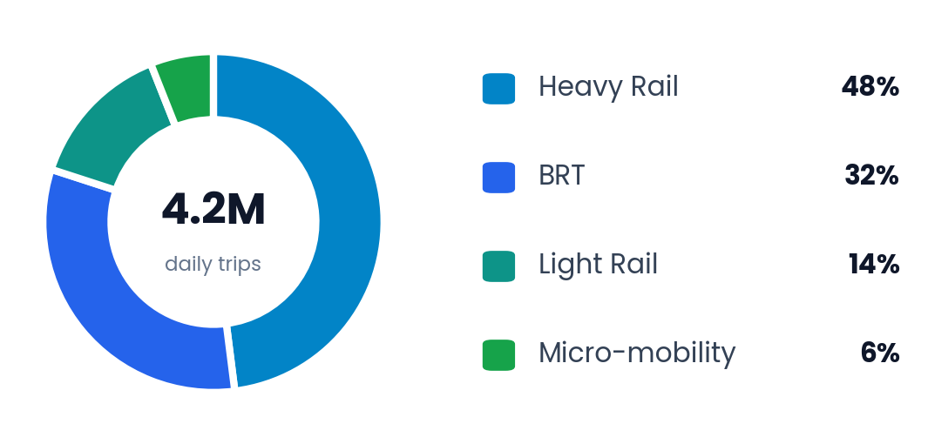
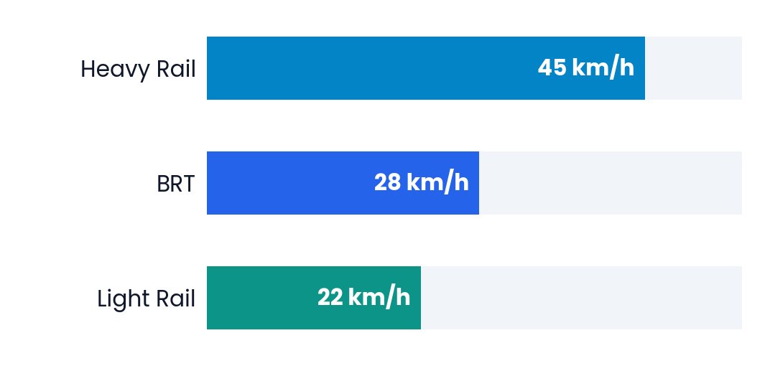
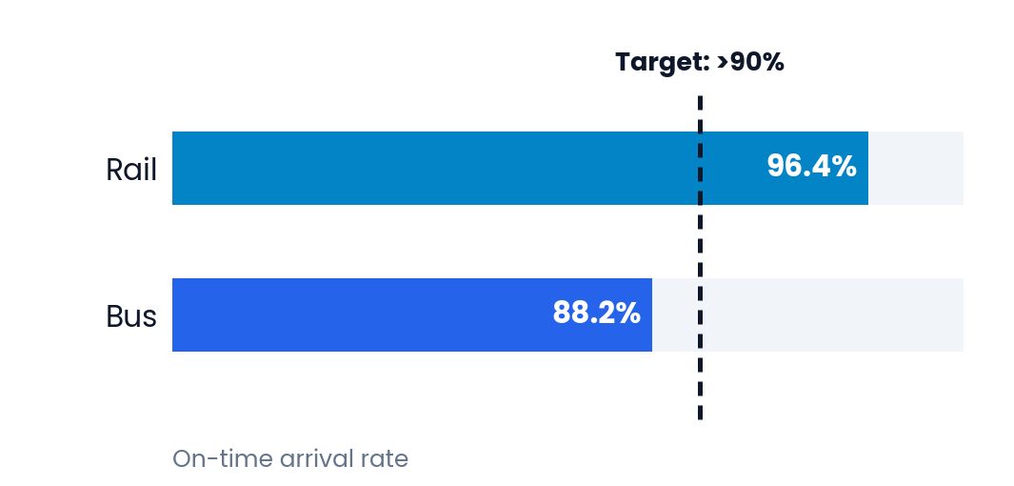
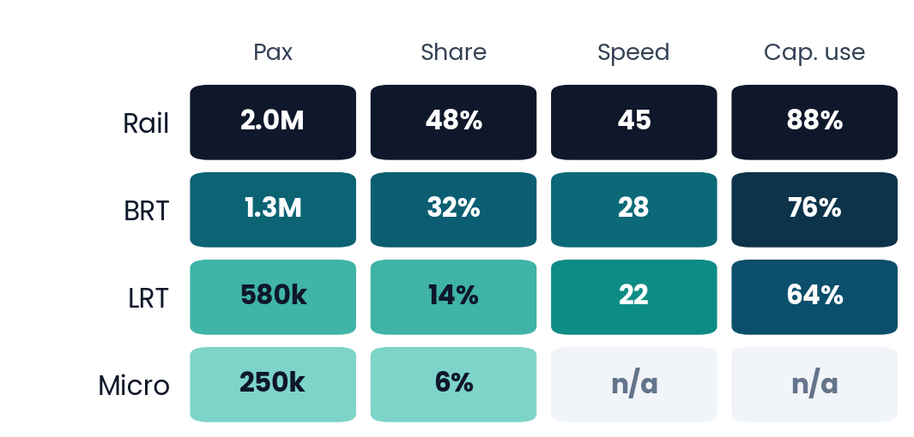
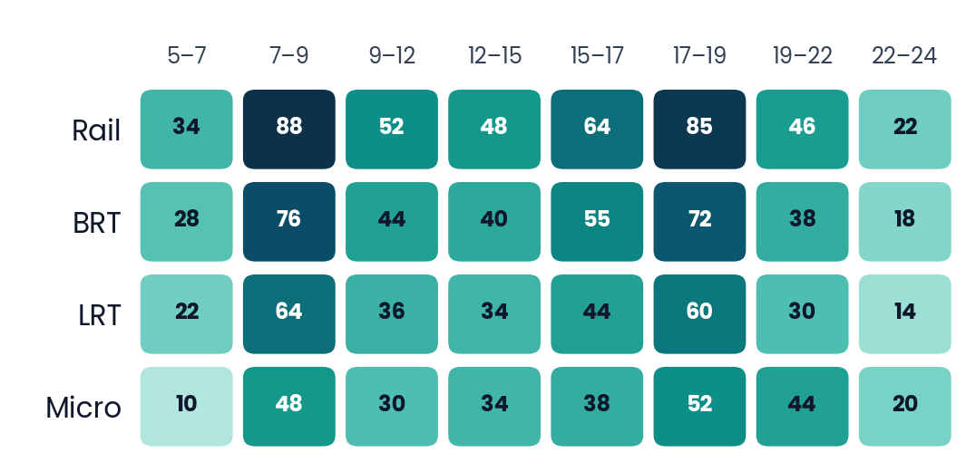
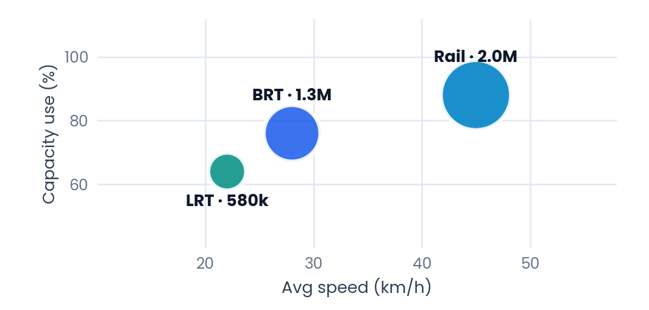
DASHBOARD VISUAL OPTIONS
Other Ways to Visualize the Dashboard
Donut chart
Bar chart
Target bar
Parts of a whole: modal share
Compare categories: speed by mode
Performance vs. a goal: on-time rate
Scorecard heat map
Time-of-day heat map
Bubble chart
Spot highs and lows across metrics
Patterns over time (illustrative values)
Relate three metrics: speed, capacity, riders
Notes:
Speaker Notes:
[Purpose] "The previous slide used progress bars, but a dashboard has many more options. Here are six visual types you could drop in, depending on the question you want to answer."
[Walkthrough] "Donuts show parts of a whole. Bars compare categories. A target bar shows performance against a goal. Heat maps reveal where values are high or low, across metrics or across the day. A bubble chart lets you read three metrics at once."
[Honesty note] "Five of these use numbers already on our slides. The time-of-day heat map uses illustrative values until we have measured data."

Slide 108




RELIABILITY & BOTTLENECKS
Primary Delay Drivers & System Bottlenecks
High Impact
Medium Impact
Capacity Limiter
Signal Conflict
Depot Charging Limits
Station Crowding
+4.2 min delay per trip at Line 4 un-prioritized intersections.
18% fleet idle time due to insufficient fast-charging bays.
+45 sec dwell times at Central Interchange platforms.
Affects 140k daily passengers during peak morning traffic.
Constrains midday bus turnaround on suburban feeder routes.
Creates knock-on delays across 3 connecting subway lines.
Fix: Transit Priority Signal roll-out
Fix: 450kW Pantograph Chargers
Fix: Platform Screen Doors & Gates

Slide 109

FUTURE INVESTMENT PRIORITIES
Strategic Transit Roadmap & CapEx
Targeted $65M infrastructure investment over 18 months to eliminate bottlenecks and expand capacity by 25%.
PILLAR 01
Q1 2027
PILLAR 02
Q3 2027
PILLAR 03
Q2 2028
Transit Priority Signals
100% Zero-Emission Fleet
Unified Fare Payment
Deploy smart signal priority at 45 key corridor intersections.
Procure 120 e-buses and build 24 rapid pantograph charging bays.
Contactless open-loop ticketing across rail, bus, and micro-mobility.
Budget: $12M • Est. Speed +15%
Budget: $45M • -18k Tons CO₂
Budget: $8M • Boarding Time -35%

